Slide 1

Entering and editing functional response curves in EwE

Slide 2
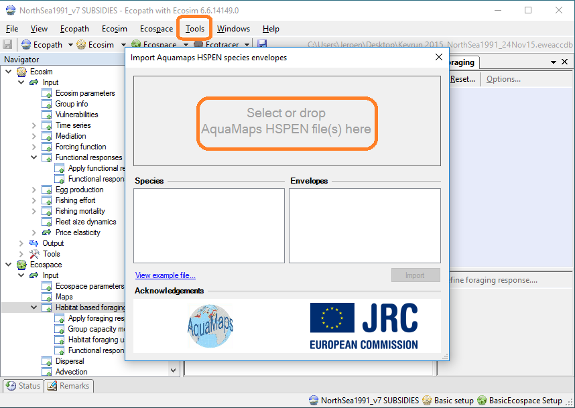
Import functional responses 1/2

Slide 3
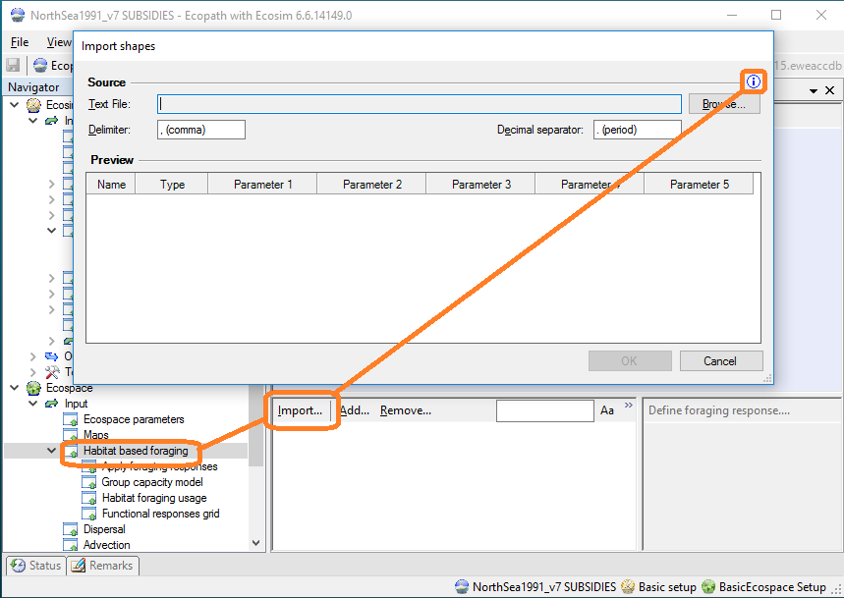
Import functional responses 2/2
Click Import Shapes info button to see a file format preview

Slide 4
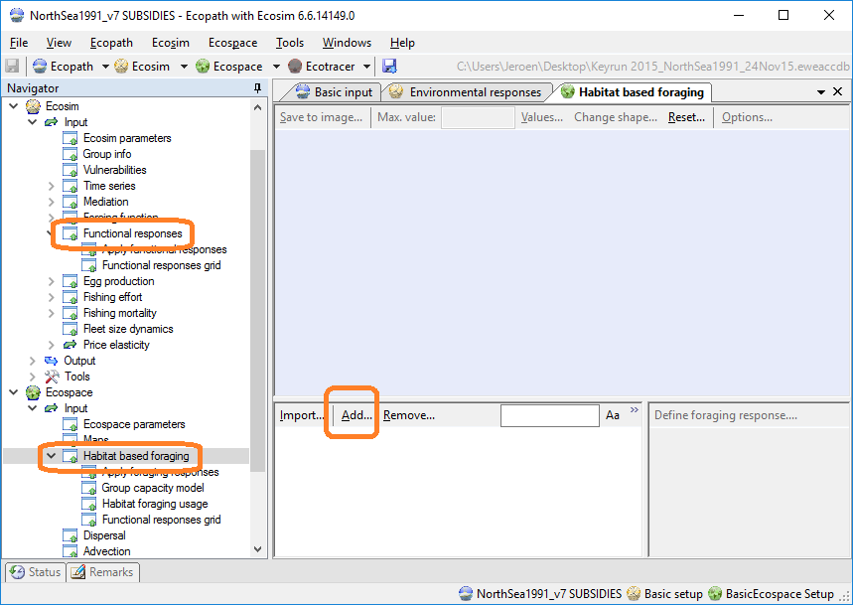
Manually add functional responses

Slide 5
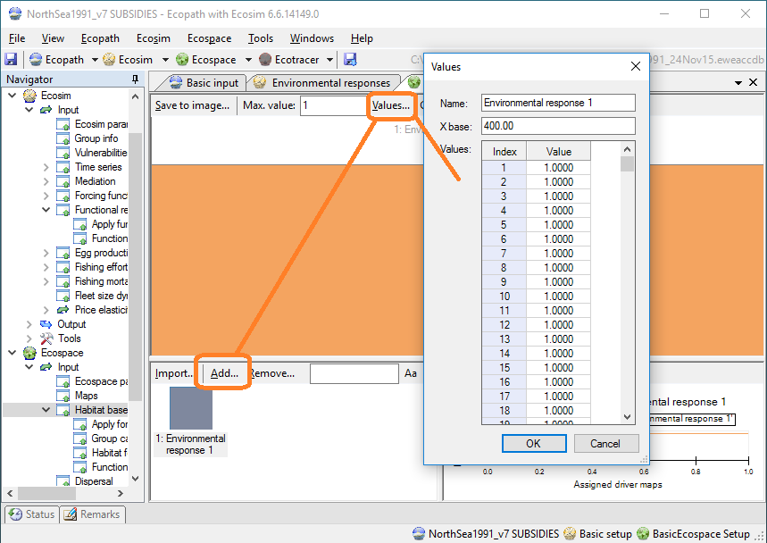
Copy/paste function values

Slide 6
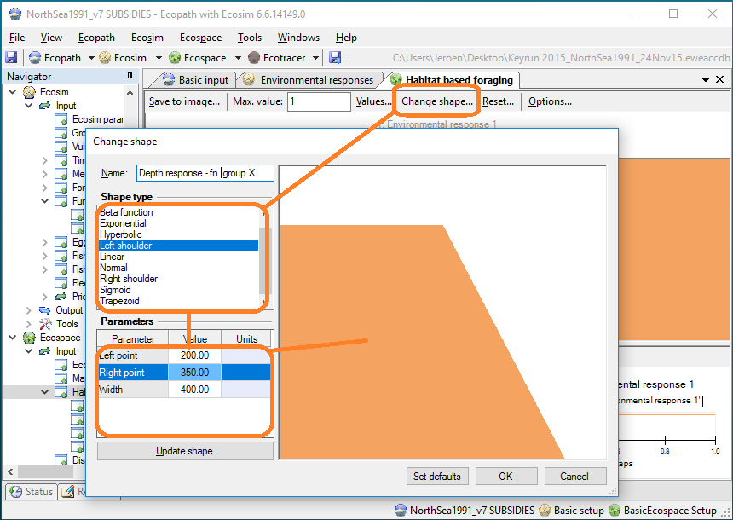
Shaping as a primitive

